Slide 1
Porthpean Camp – Monday 15th June – Wednesday 17th June 2020 (2 nights)
Learn with a breath of fresh air

Slide 2
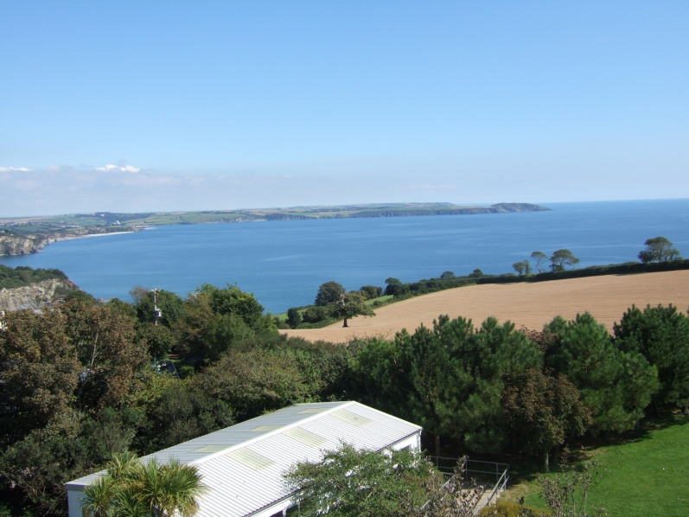
Porthpean site …
The Centre is situated just outside of St Austell and enjoys spectacular views over the sea and local countryside. Sleeping accommodation consists of large canvas tents.
The camping element is supported by a range of permanent buildings including a centrally heated dining hall, staff lounge, toilet and shower blocks, and drying room.

Slide 3
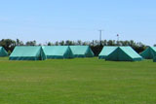
Porthpean site (cont)…
Tents are arranged in ‘villages’ to accommodate a maximum of 38 children and up to 4 leaders.
There are 5 villages.
Each village has 7 tents and 1 wooden cabin (sleeps 2).
The cabin is lockable and is for leaders’ use only.
All the tents are floor boarded and the centre provides a vinyl foam mattress on which to sleep.
All visitors must bring their own sleeping bags and pillows.

Slide 4
Catering Service…
The catering service is available to all groups. A fixed menu is provided.
A vegetarian option is always available.
We will provide a service that consists of a cooked breakfast, packed lunch and evening meal.
The staff and children will have serving and cleaning duties during the meals to ensure mealtime run smoothly and it is clean for the next group.

Slide 5
Personal Kit List
It is not possible to give a comprehensive list of kit requirements as this will vary according to the length of stay and activities undertaken. Below is a set of guidelines from which you should draw up your own list.
Suitable clothing and footwear for activities planned. Footwear MUST be worn when participating in water sports activities. Old trainers, plimsolls, wet shoes etc are all fine. (Flip Flops, Crocs and Reefs ARE NOT SUITABLE). Wellington boots or old trainers for land based activities. A general rule of thumb is plenty of OLD clothing.
Night wear

Slide 6
Personal Kit List continued
Waterproof jacket and trousers
Swim wear
Sun hat, woolly hat and sun cream
Personal toiletries including towel and hand soap
Sleeping bag, pillow. blanket if required
Torch
Lunch box and drinks container
Mug for bedtime drink
Any medication needed (asthma inhalers, allergy tablets etc) given to leader.

Slide 7
Personal Kit List continued
2 black bin liners for dirty and wet clothes
Small rucksack for day use
Please pack everything into a medium sized bag preferably not a suitcase ensuring:
EVERYTHING IS LABELLED WITH YOUR NAME

Slide 8
Remember the Cornish Climate cannot always be relied upon.
Make sure you bring warm clothes even in July.
Every year we have massive amounts of lost property, which is never claimed. Where possible, please ensure all children’s clothing etc is accounted for. The centre will not take responsibility for the loss of personal equipment.

Slide 9
Activities …

Slide 10
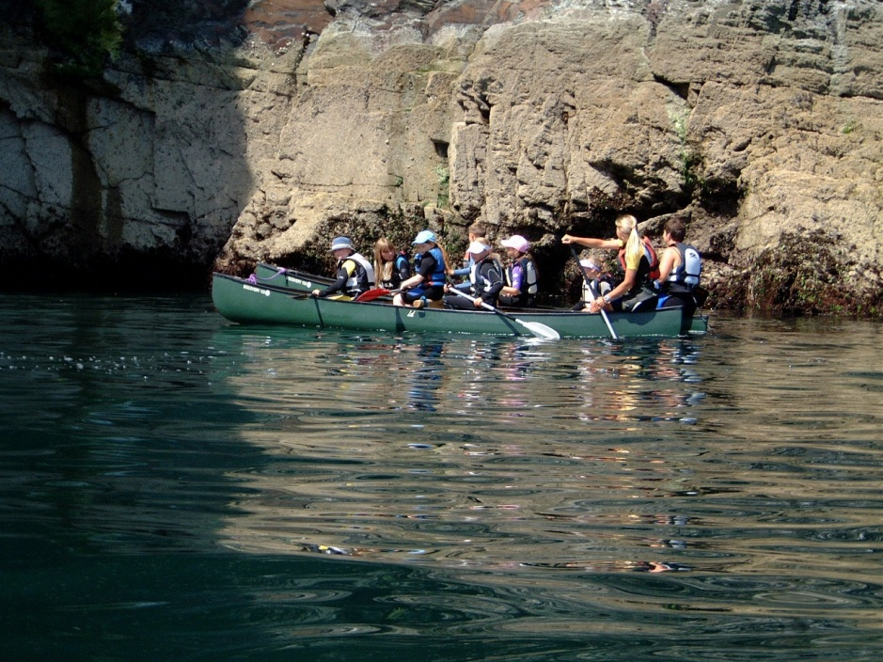
Full day on the Beach….
Explore the coastline in canoes and kayaks
Walk your way along the cliffs by coastal traversing
Try your hand at Stand Up Paddleboarding (SUP)

Slide 12
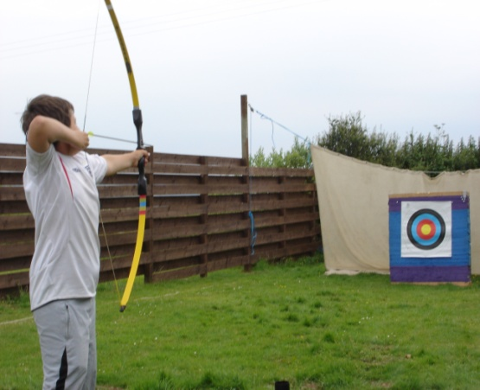
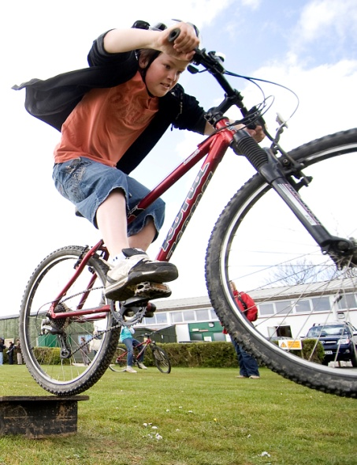
Half days Archery & Cycling (these activities may change based on weather/availability etc neared the time)
Archery is an excellent activity to
develop concentration skills and
manual dexterity in individuals of
all abilities.
Cycle ride through
the woods on a circular course

Slide 13
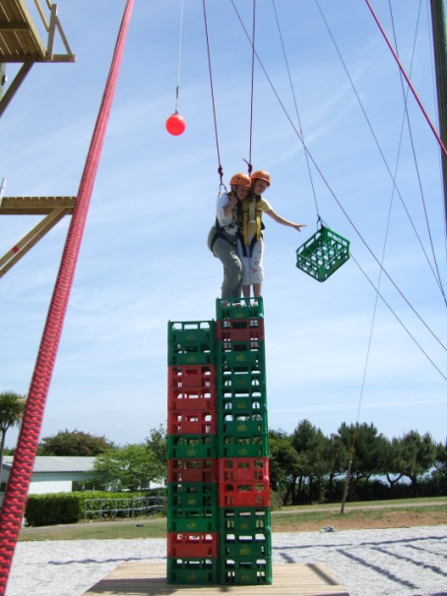
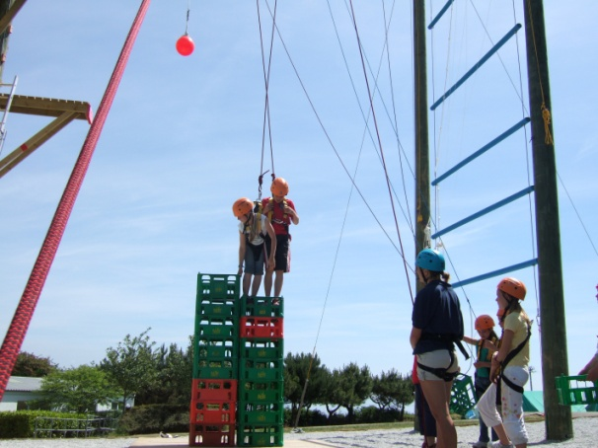
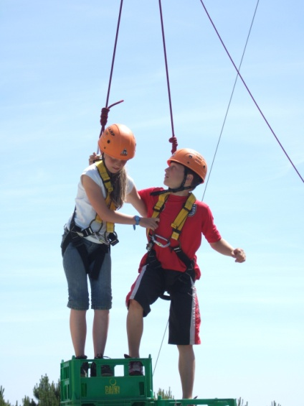
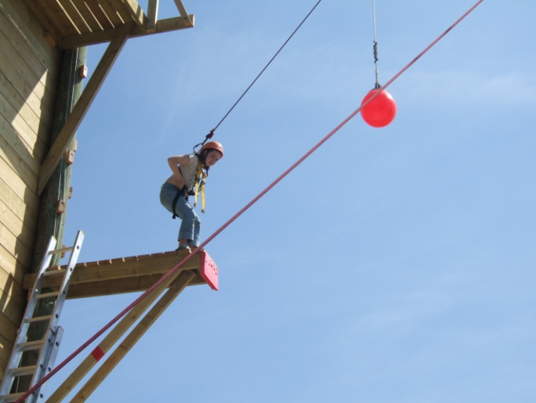
Half Day on the High Ropes Course
Test your nerve on the leap of faith, fly down the zip wire and tackle the Jacobs Ladder. Build a crate tower and descend the abseil wall.

