Slide 1

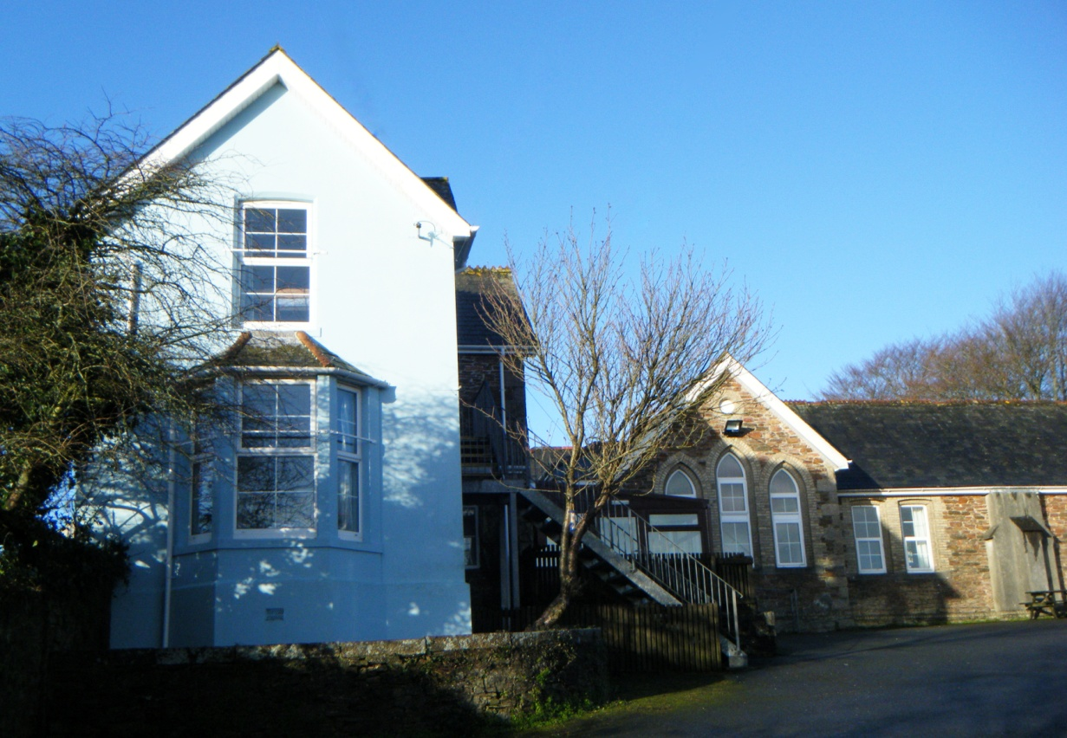
Delaware Outdoor Education Centre

Slide 2
Delaware Outdoor Education Centre.
The centre is managed by Cornwall Council.
The centre offers excellent equipment. Qualified instructors provide opportunities for developing a wide range of skills in a safe and enjoyable environment.
Provision is made at the centre for accessibility including access for wheelchair users to changing rooms, showers and toilets.

Slide 3
Delaware centre has undertaken Risk Assessments for all activities they lead.
The equipment provided at the centre is fit for purpose, regularly inspected and maintained and checked thoroughly before use.

Slide 4

Staff…
All staff hold a relevant National Governing Body qualification or Cornwall Council approved qualifications
First Aid Qualified
All staff hold an enhanced CRB disclosure
Approachable, friendly and professional tutors who enjoy their job
L12008/ R0353

Slide 5
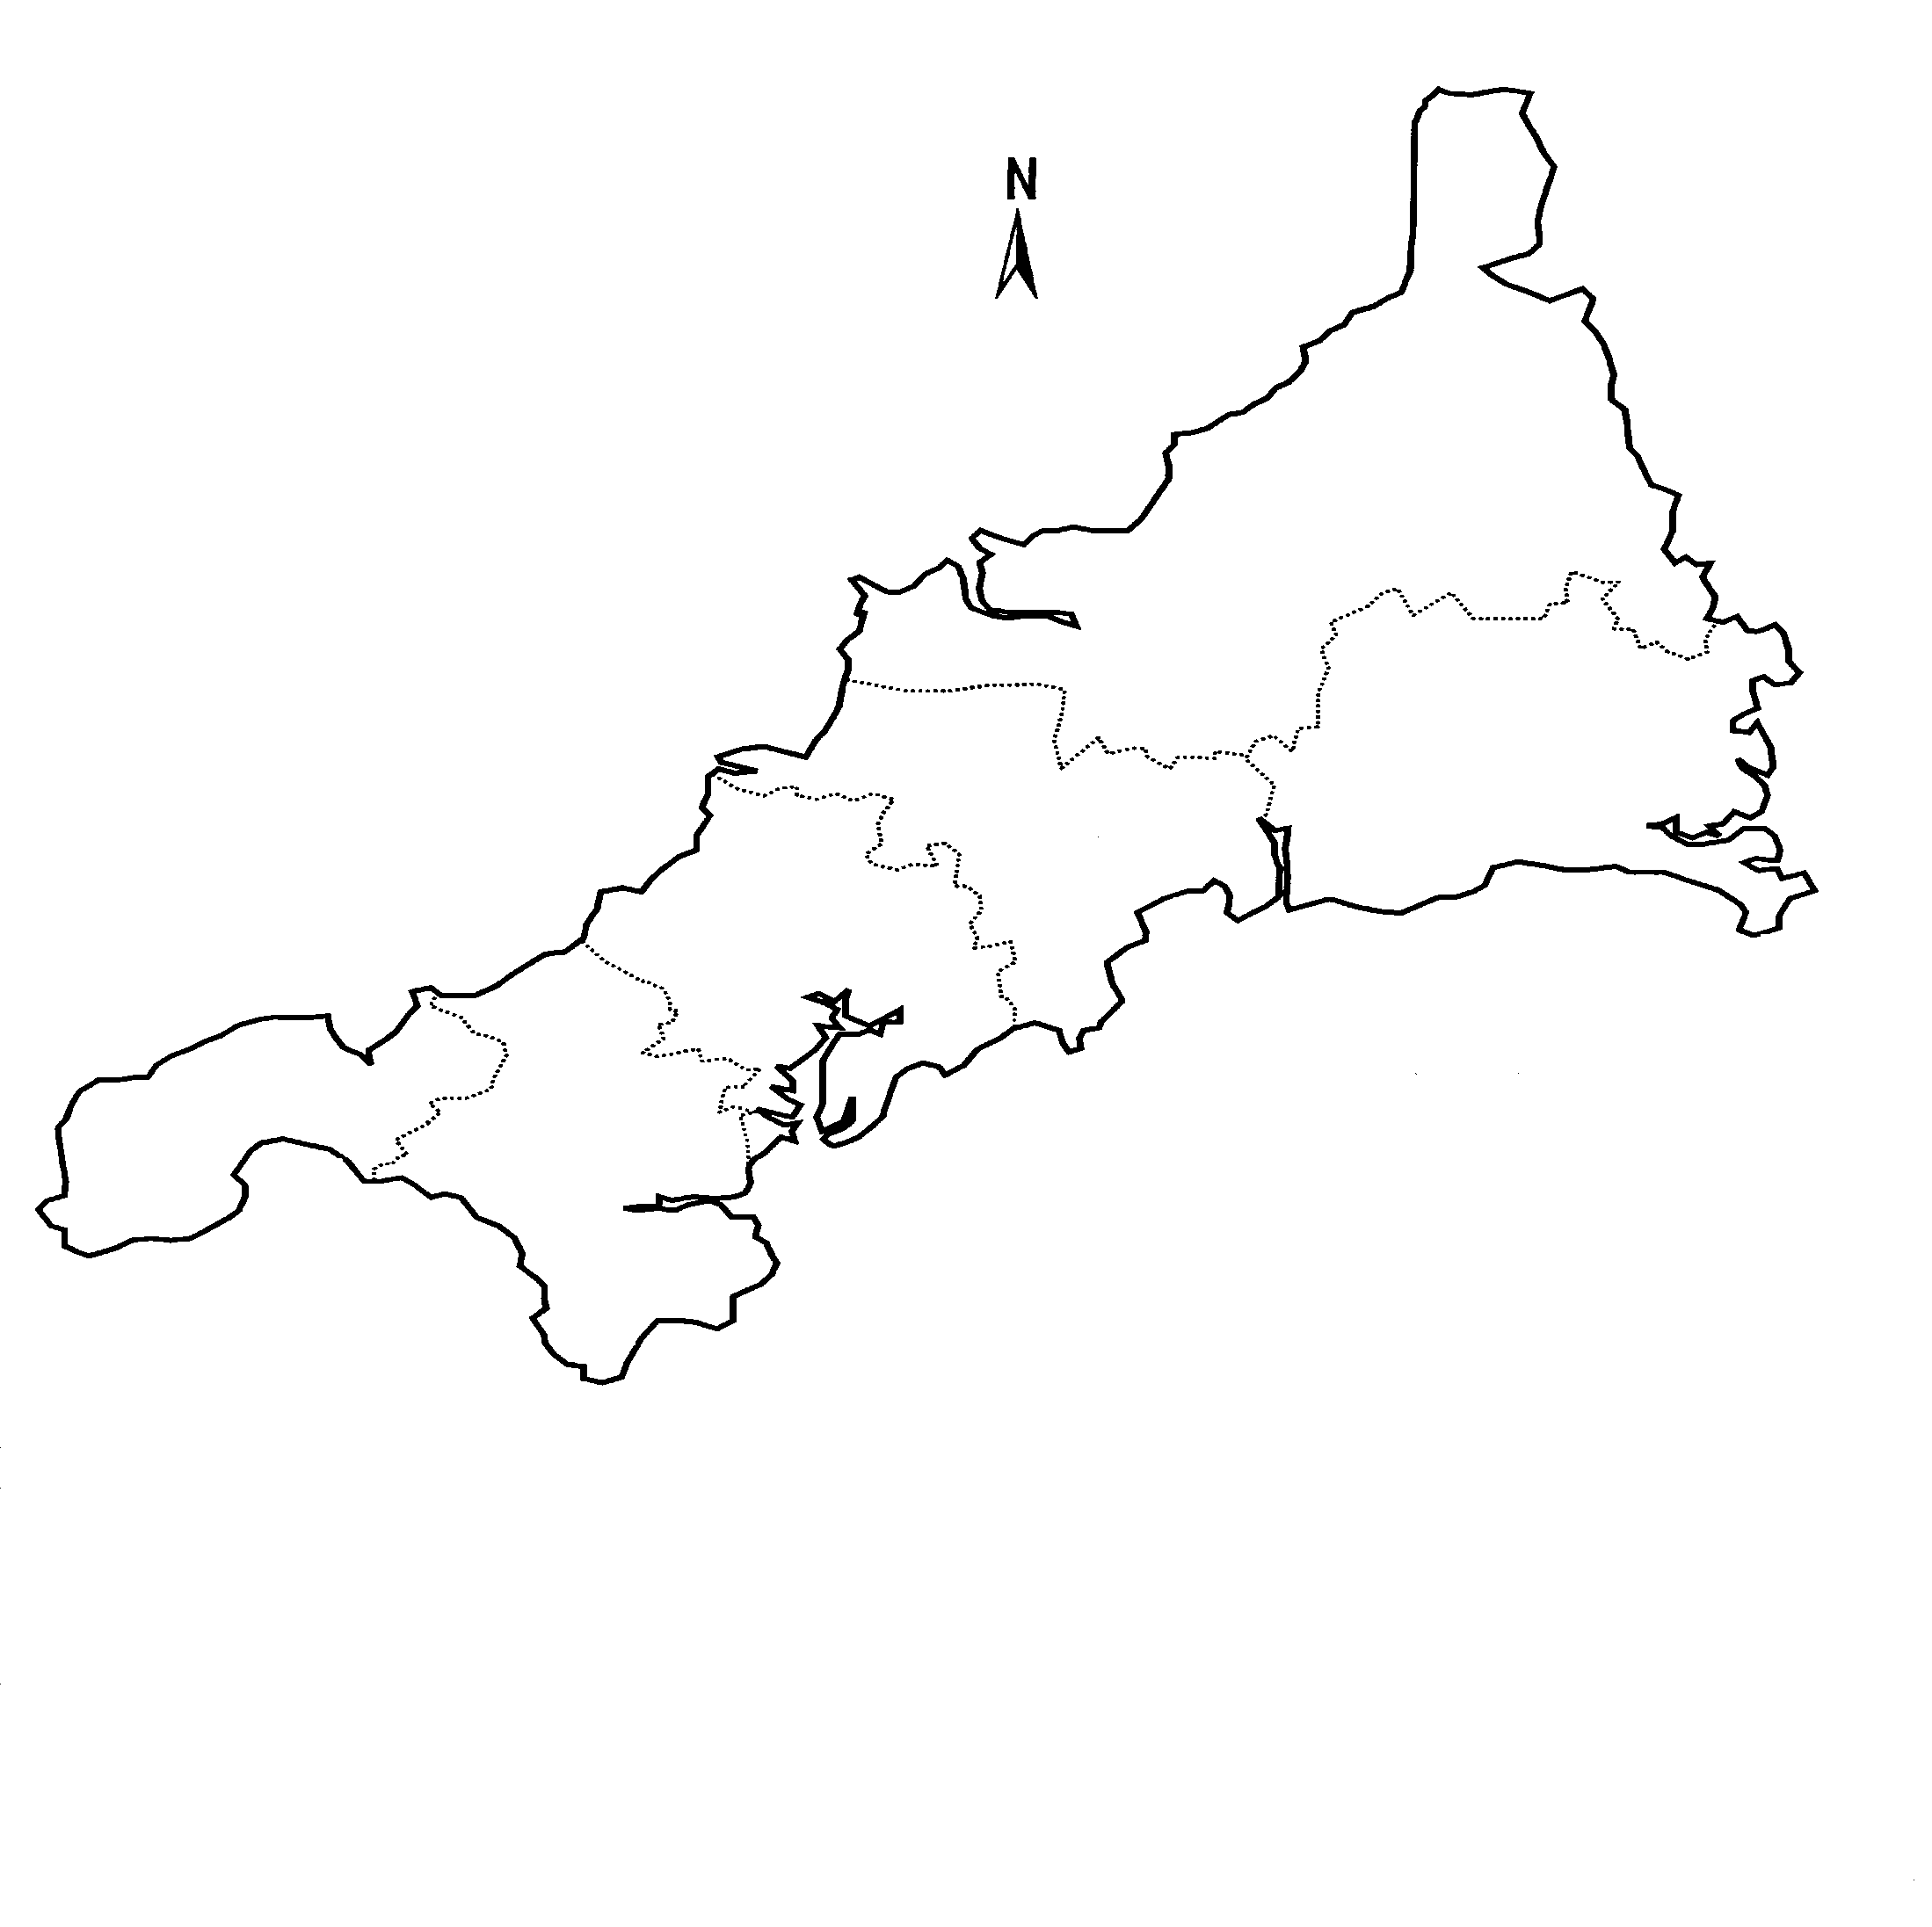
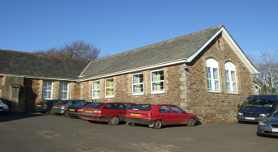
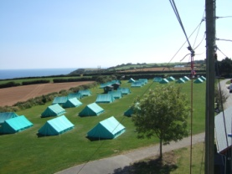
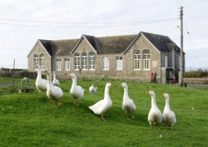
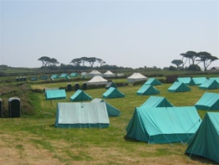
Outdoor Education Centres
DELAWARE OEC
PORTHPEAN
OEC
CARNYORTH
OEC
‘a breath of fresh air’
IOS CAMP SITE

Slide 6
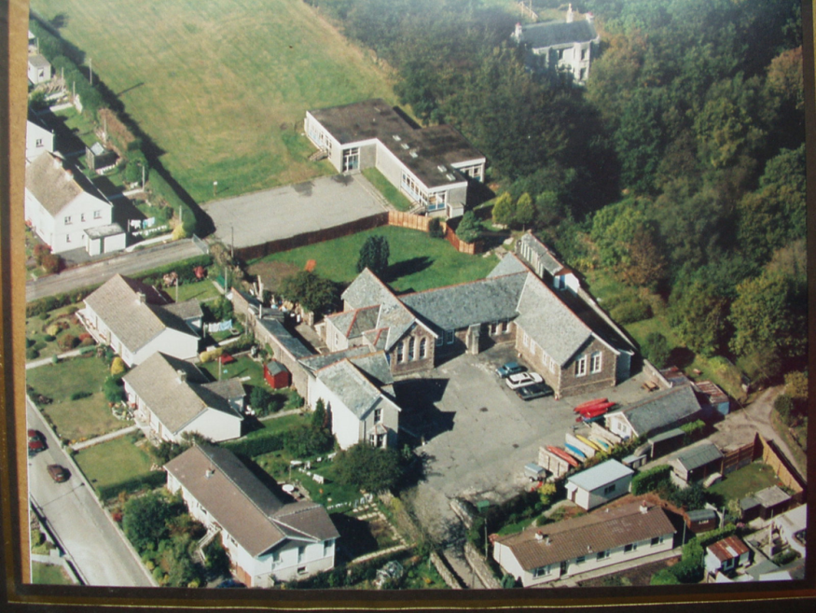
The Centre …
The Centre is a converted Victorian Primary School situated on the outskirts of Gunnislake in the picturesque Tamar Valley. The two residential buildings are known as ‘The Old School’ along with overflow accommodation described as the ‘Headmasters House’. The whole centre will accommodate up to 67 guests.

Slide 7

The Main Centre…
Provides dormitory accommodation for up to 49 people, plus kitchen, dining room/common room, showers, toilets and a large drying room. Central heating and double glazed windows make the Centre a very comfortable and user friendly building all year round.

Slide 8
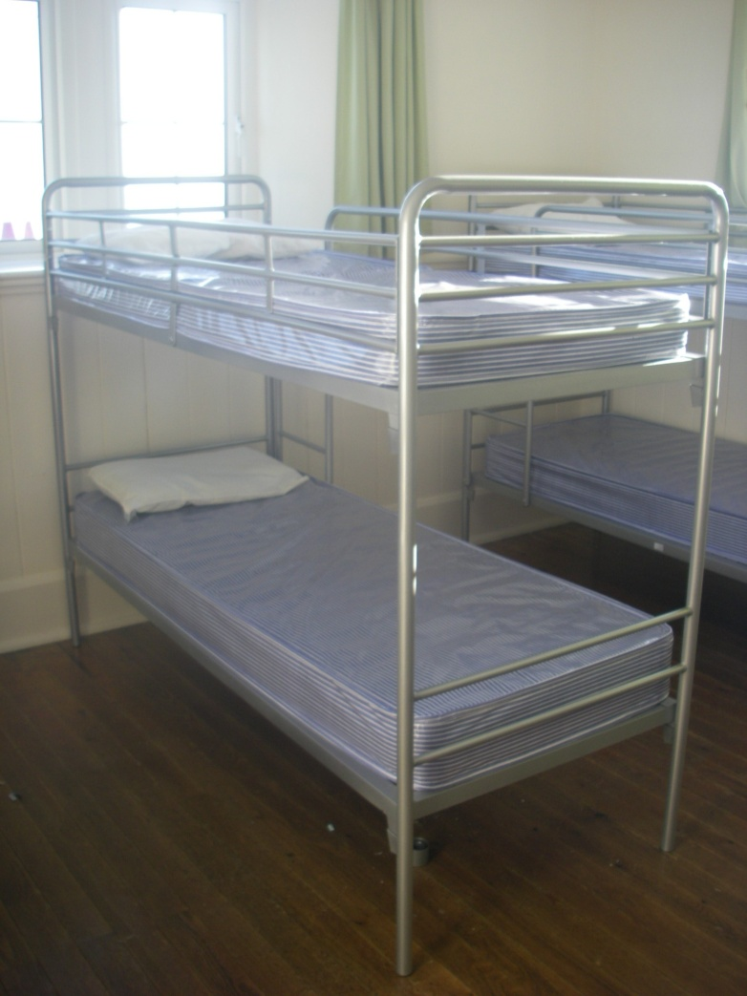
Accommodation…
There are 5 large dormitories in the Main Centre; four with 4 bunks sleeping 8 and one with 6 bunks sleeping 12.
There are 3 staff rooms; two sleeping 2 and 1 single room.

Slide 9
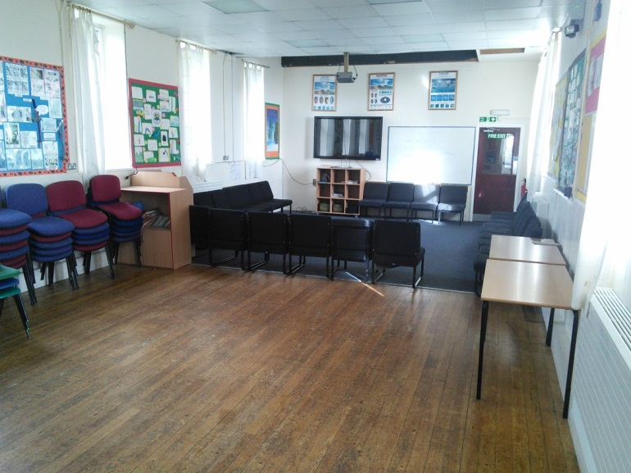
Dining Room / Common Room …
The hall doubles as both dining room and common room.
The area has polished wood flooring and is equipped with 8 folding tables and stacking dining chairs.
The common room end is carpeted, has a number of easy chairs, television, a DVD player, projector and a small library.

Slide 10
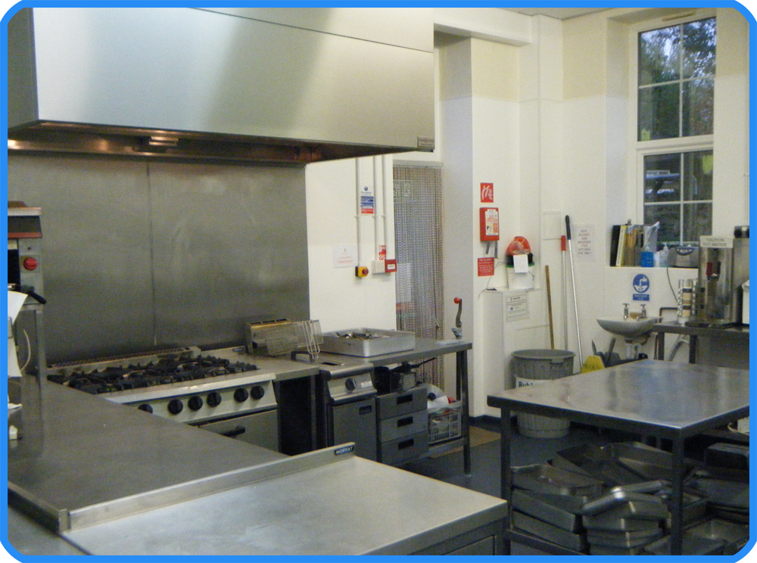
Catering Service …
The catering service is available to all groups. A fixed menu is provided.
A vegetarian option is always available.
We will provide a service that consists of a cooked breakfast and evening meal. Ingredients will be provided to make packed lunch.
Group members need lunch boxes and drinks bottles.

Slide 11
Suggested clothing and equipment
For day time water / land based activities
Underwear
Several pairs of warm socks
T shirts
Trousers/Track suits – not jeans
Jumpers / Sweat Tops / Fleeces
A warm coat
Waterproof jacket and trousers (The Centre has a limited number for loan)
Wellies or walking boots
A pair of trainers (preferably old)
Old shoes (which may get wet)
A warm hat, scarf, gloves
Small rucksack / day bag
Cap/sun hat and sun cream
Personal medical requirements
Packed lunch for the first day
Unbreakable drinks container with drink for first day

Slide 12
For night time
Sleeping bag (packed separately)
Bottom sheet for the bed
Pillow and Pillow case
Night clothes
Towel
Wash bag and toiletries
In the centre
Clothing and footwear for indoor use
Pencils, crayons, books
2 black bin liners for wet and dirty clothes
Several carrier bags
No electrical items!

Slide 13
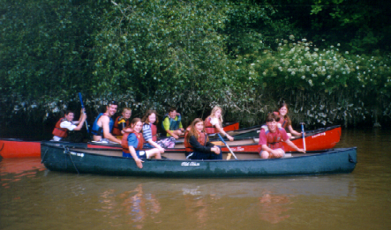
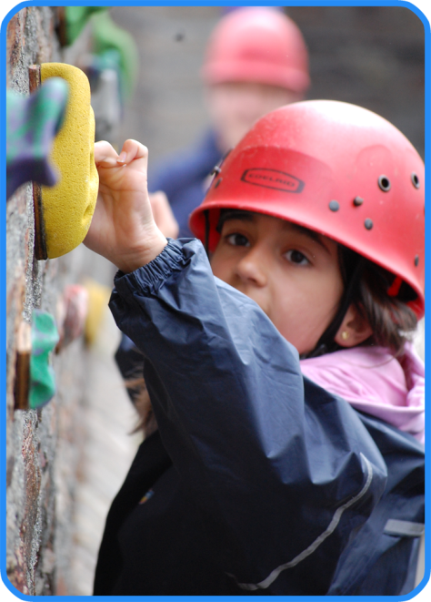
Activities….
Open Canoeing
A modern slant on a wonderful traditional activity. Sessions take place on sheltered pools, lakes or rivers depending on ability.
Climbing and Abseiling
Be introduced to the exciting challenge of scaling our new indoor climbing wall or tackle various climbs at a range of wonderful outdoor crags.

Slide 14
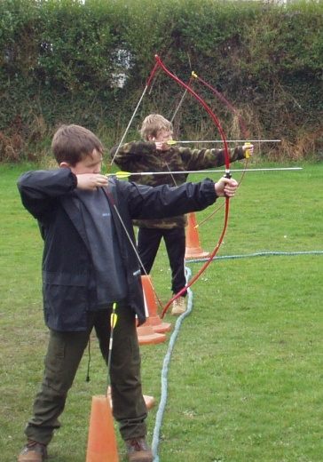
Activities
Archery
One of our favourite sessions. A steady hand, a good eye and a patient mind are all the skill that you will require during this most ancient of activities.

Slide 15
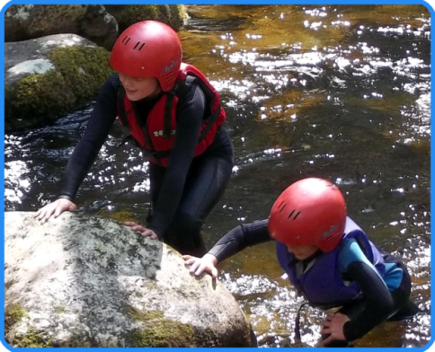
Activities
Gorge Walking
Pick your route carefully.
Guide your team up this natural
challenge

Slide 16
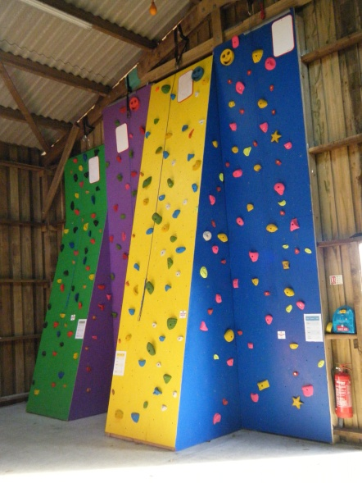
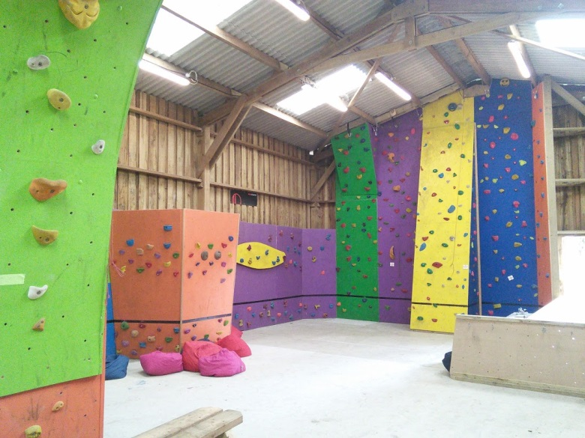
Activities
Large indoor climbing barn which offers 18 ropes with 50 routes, over 40 metres of traversing.
The opportunity to have a go at abseiling within an indoor environment.

Slide 17
Evening activities….
There is a large sports field that can be utilised and also a garden area with benches.
Quiz nights & talent shows.
Movie & popcorn night!

Slide 18
Day 1
9am – Leave school
10.30am – Arrive and unpack
12.00pm – Lunch (from home)
1.00pm – 1st activity
5.30pm – Dinner and lunches

Slide 19
Day 2
7.30am – Up and prepare
8.00am – Breakfast
9.00am – Activity
12.00pm - Lunch
1.00am – Activity
5.30pm – Dinner and lunches

Slide 20
Day 3
7.30am – Up and pack
8.00am – Breakfast
9.00am – Activity
12.00pm - Lunch
1.00am – Leave

Slide 21
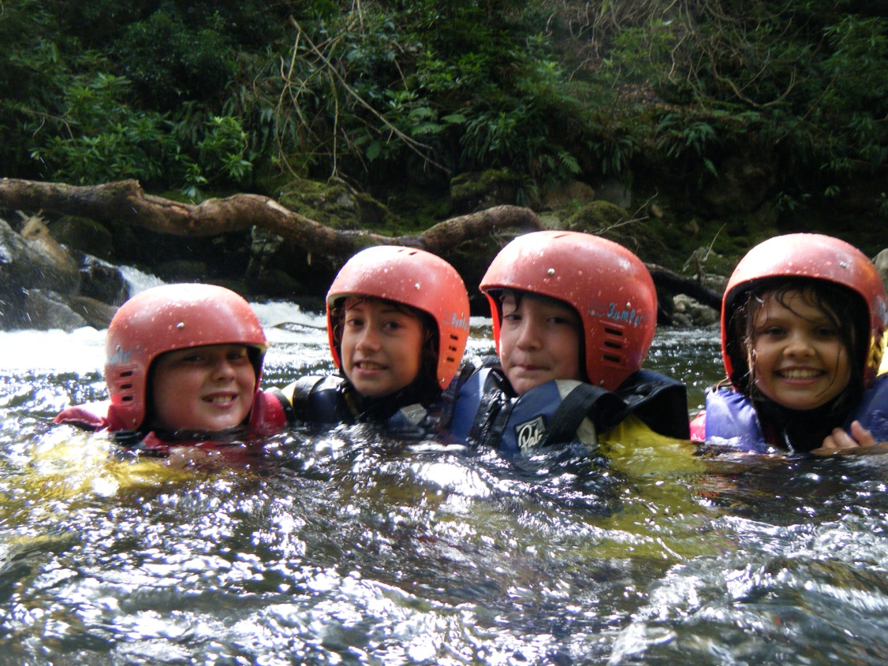
Delaware Outdoor Education Centre
‘raising achievement and aspiration through adventure & outdoor learning’

